Slide 1
Motion Analysis
Last updated: 8-5-24
Solem, J. E., 2012. Programming Computer Vision with Python: Tools and algorithms for analyzing images. "O'Reilly Media, Inc.“ (Ch. 10).
Szeliski R., Computer Vision - Algorithms and Applications, Springer, 2011 (Ch. 7).

Slide 2
Motion Analysis
is a critical area in computer vision that deals with extracting information about moving objects from image sequences.
By analyzing how pixels change over time, we can gain valuable insights into the movement of objects in a scene. This information has numerous applications in various fields, including robotics, surveillance, and human-computer interaction.

Slide 3
Motion Analysis – Key Tasks
Motion detection: Identifying the presence of motion in a scene. This is often the first step in motion analysis and can be achieved through various techniques like background subtraction or frame differencing.
Object tracking: Following the movement of an object over time. Tracking algorithms use motion information to estimate the object's trajectory and predict its future location.
Trajectory analysis: Understanding the path an object takes in a scene. Trajectory analysis can reveal information about the object's motion patterns and behavior.
Video analytics: Classifying the actions performed by objects in a scene. This involves recognizing complex motions and interpreting their meaning in the context of the scene.
Notes:
Motion analysis involves several key tasks:
Motion detection: This is the initial step, where the system determines if there's any movement in a scene. Techniques like background subtraction (comparing the current frame to a static background model) or frame differencing (comparing consecutive frames) are commonly used.
Object tracking: Once motion is detected, the system tracks the moving object. Tracking algorithms use information about the object's motion to estimate its path and predict its future location.
Trajectory analysis: By analyzing the object's path, we can understand its motion patterns and behavior. Trajectory analysis helps reveal insights about the object's purpose or intent.
Video analytics (Activity recognition): In complex scenarios, motion analysis can be used to recognize the actions performed by objects. This involves higher-level processing to interpret the motion patterns and classify them into meaningful activities.

Slide 4
Optical Flow for Motion detection
Optical flow is the pattern of apparent motion of objects, surfaces, and edges in a visual scene caused by the relative motion between an observer and the scene.
Optical flow helps us understand how objects in a video move.
Applications
Motion detection
Video compression
Object tracking

Slide 5
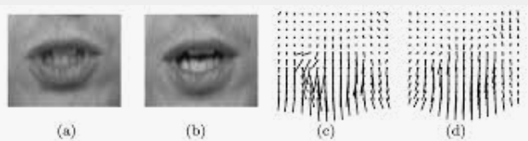
Key Concepts in Optical Flow
Motion Vectors: Indicate the direction and speed of object movement.
When we talk about optical flow, we focus on motion vectors, which are like arrows showing the direction and speed of movement.
Brightness Constancy: Assumes that the brightness of a point in an image remains constant over time.
Spatial and Temporal Smoothness: Assumes smooth changes in motion over space and time.

Slide 6
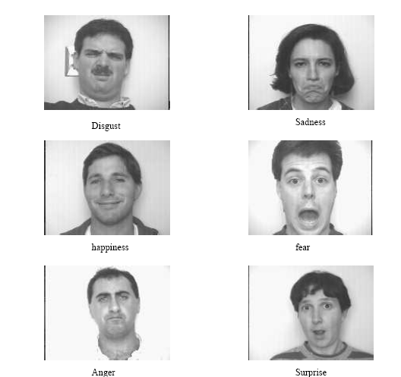
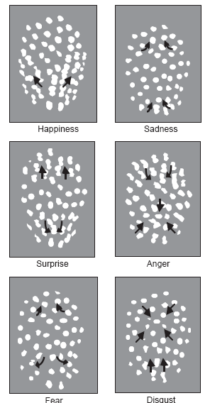
Example using optical flow: recognizing facial expressions
Recognizing Human Facial Expression (1994)
by Yaser Yacoob, Larry S. Davis

Slide 7
Methods for Calculating Optical Flow
Differential Methods:
Lucas-Kanade (LK) Method: Uses a small window of pixels to approximate motion.
Horn-Schunck Method: Introduces a global smoothness term to minimize motion discontinuities.
Feature-Based Methods: Track specific features like corners and edges across frames.

Slide 8
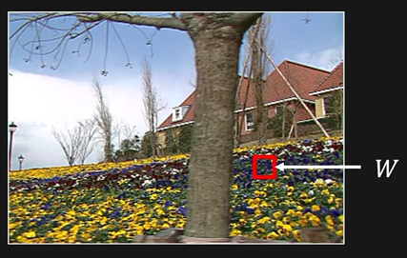
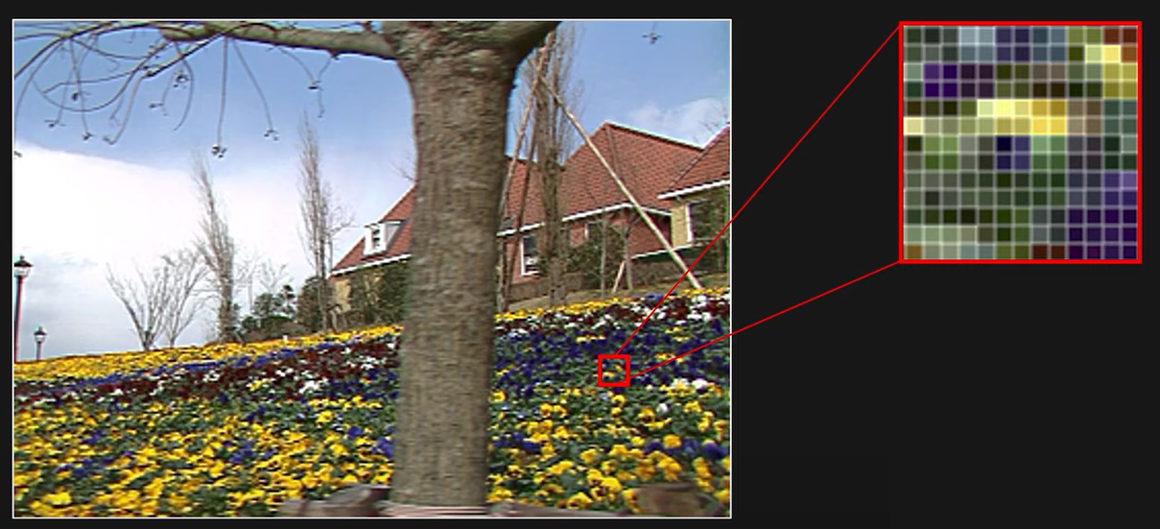
Lucas-Kanade (LK) Method
LK method uses a small window of pixels to approximate motion. Assumptions:
This approach assumes that all pixels within the window will have similar motion.
Small displacement of image points
Constant brightness

Slide 9

Lucas-Kanade (LK) Method
Equation: Solves for motion using image gradients.
The equation it uses involves image gradients, which measure how the brightness of the image changes in different directions.

Slide 10
Lucas-Kanade (LK) Method (Contd.)
Strengths:
Efficiency: Typically faster because it calculates motion for each small window independently.
Robust in High-Texture Areas: Works well in areas with significant texture where local variations provide plenty of information for motion estimation.
Weaknesses:
Limited by Aperture Problem: The method can struggle in areas with uniform texture or at the edges of objects where the small window might not capture enough diverse information.
Not Suitable for Large Motions: Since it relies on small windows, large motions can exceed the window size, leading to inaccurate estimations.

Slide 11
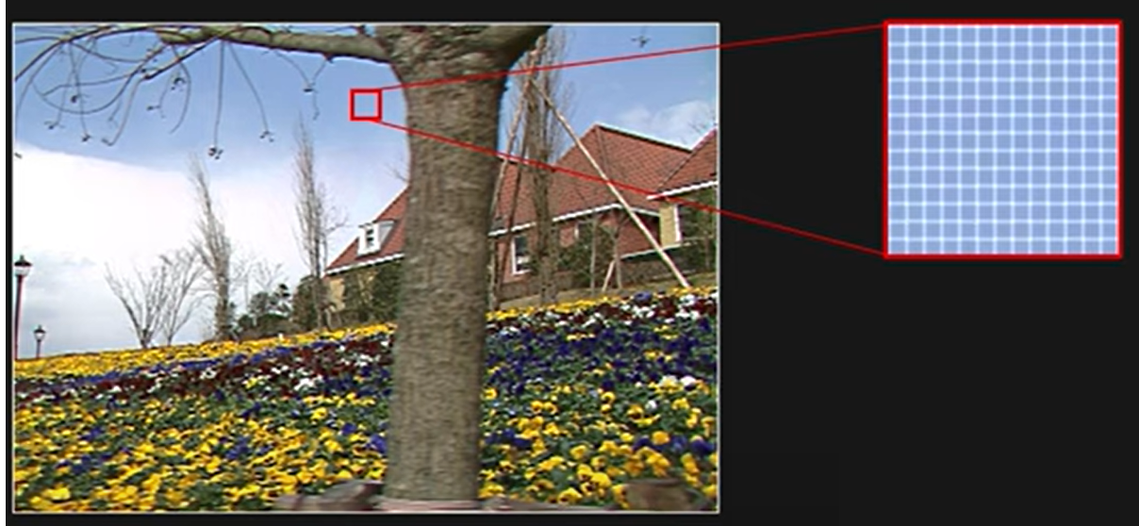
Smooth region (bad)
No large gradients in the regions. Optical flow cannot be computed reliably.

Slide 12
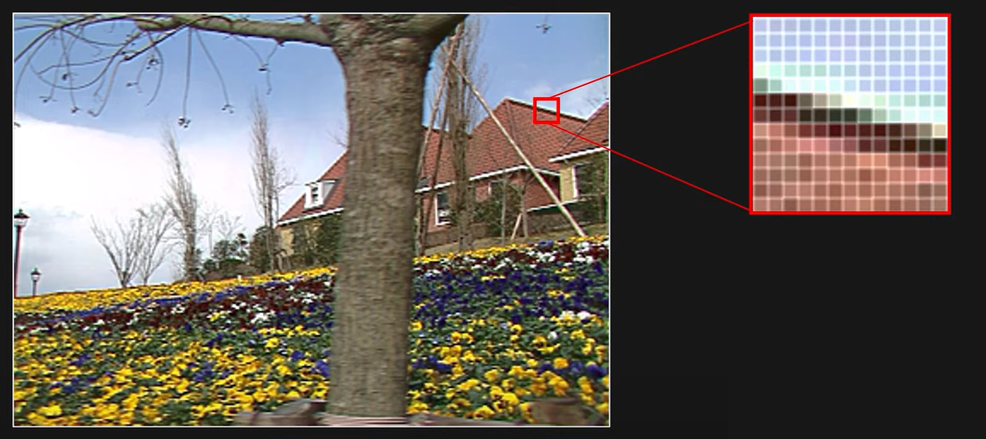
Edges (bad)
Prominent gradient in one direction only (remember the aperture problem). Optical flow cannot be computed reliably.

Slide 13
Textured Regions (Good)
Large and diverse gradient magnitudes. Can reliably compute optical flow.

Slide 14
The Horn-Schunck Method
The Horn-Schunck method is another way to calculate optical flow.
Developed by Horn and Schunck in 1981.
Unlike the Lucas-Kanade method, which looks at small regions, the Horn-Schunck method computes the motion for every pixel in the image.
It uses a global smoothness constraint to ensure the motion is smooth across the entire image, minimizing sudden changes in motion.

Slide 15
Understanding the Global Smoothness Constraint
Principle: The smoothness constraint in the Horn-Schunck method is based on the idea that in most real-world scenarios, objects move in a relatively smooth and consistent manner.
The motion of neighboring pixels is typically correlated unless there is a boundary between different objects or other significant discontinuities.

Slide 16
Understanding the Global Smoothness Constraint
Mathematical Formulation: The Horn-Schunck method minimizes a global energy functional that includes two terms:
Data Term: Encourages the flow vectors to be consistent with the image brightness constancy assumption (similar brightness between corresponding pixels across frames).
Smoothness Term: Penalizes variations in flow vectors between adjacent pixels, promoting smooth changes in the flow field across the image.

Slide 17

Understanding the Global Smoothness Constraint
The energy functional 𝐸E is given by:
where:
𝑢 and 𝑣 are the horizontal and vertical components of the optical flow.
𝐼_{𝑥}, 𝐼_{𝑦}​, and 𝐼_{𝑡}​ are the spatial and temporal derivatives of the image brightness.
𝛼 is a regularization parameter that controls the influence of the smoothness term relative to the data term.
∣∇𝑢∣²+∣∇𝑣∣² represents the square of the gradients of the flow components, enforcing the smoothness.

Slide 18
Horn-Schunck Method: Mathematical Formulation
Iterative Solution: The Horn-Schunck method uses an iterative approach to minimize the objective function.
It updates the flow estimates in each iteration using the image gradients.

Slide 19
Example: Smooth Flow in a Cloudy Sky
Scenario: Imagine a video sequence capturing the movement of clouds in the sky. The motion of the clouds is generally smooth and gradual, without abrupt changes in velocity or direction.
We will see how optical flow estimation using Horn-Schunck method is expected to work in this scenario.

Slide 20
Example: Smooth Flow in a Cloudy Sky
Application of the Horn-Schunck Method:
Data Collection: The sequence involves multiple frames where clouds move slowly across the sky.
Optical Flow Estimation: Applying the Horn-Schunck method to this scenario would involve calculating the motion vectors that describe the movement of each pixel from one frame to the next.
Smoothness Constraint: The smoothness constraint plays a crucial role here. Since clouds are fluid and have a gradual, coherent movement, the flow vectors of neighboring pixels should not differ dramatically. The method, therefore, promotes a uniformly flowing motion field across the entire sky.

Slide 21
Example: Smooth Flow in a Cloudy Sky
Outcome:
The resulting optical flow vectors would show a gentle, continuous motion without sharp breaks, except perhaps at the edges of the frame or where different cloud formations meet.
The flow field would visually represent the slow and steady drift of the clouds, with all vectors pointing in the general direction of the movement and having similar magnitudes.

Slide 22
Example: Smooth Flow in a Cloudy Sky
Summary
This example highlights how the global smoothness constraint ensures that the optical flow is realistic and reflects the actual physical behavior of the scene being analyzed.
It avoids unrealistic jumps in flow vectors between adjacent pixels, which would not correspond to the true nature of the clouds' movement.

Slide 23
Comparing the LK and HS methods
Horn-Schunck Method: Computes a dense optical flow field, estimating motion for every pixel in the image.
Lucas-Kanade Method: Uses a small window of pixels to approximate motion, focusing on tracking specific features.

Slide 24
Comparing the LK and HS methods
Advantages of Horn-Schunck Method
Dense Flow Field: Provides motion estimates for every pixel.
Global Consistency: Ensures smooth motion across the entire image.
Better for Large Displacements: Can handle larger movements effectively due to its global approach.
Disadvantages of Horn-Schunck Method
Computationally Intensive: Requires more computation due to its dense field estimation.
Sensitive to Noise: Can be affected by noise in the image.
Requires Smoothness Assumption: Assumes that the motion is smooth across the image, which may not always be true.

Slide 25
Comparing the LK and HS methods
Advantages of Lucas-Kanade Method
Less Computationally Demanding: Focuses on small windows of pixels, making it faster.
Robust to Noise: More robust to noise due to its local approach.
Good for Small Displacements: Effective for tracking small, local movements.
Disadvantages of Lucas-Kanade Method
Sparse Flow Field: Only provides motion estimates for specific points.
Local Consistency: Does not ensure global consistency, which can lead to inaccuracies in large displacement scenarios.
Assumes Small Movements: Assumes that the movement of points is small, which may not be true in all cases.

